Slide 1

CHHATTISGARH SWAMI VIVEKANAND TECHNICAL UNIVERSITY , BHILAI (C.G.) INDEPENDENT PROJECT - Covid 19 Probability Detector
By :1.) Sneha Jha 2.) Chittaloori Likhitha
Roll No : 300012821019 Roll No : 300012821010
Enrollment No: CB4668 Enrollment No: CB4658
BTech (Honors) CSE Data Science
University Teaching Department
2022-23

Slide 2
S
CONTENTS
01
Introduction
02
Literature Review or Background Information:
03
Methodology or Materials and Methods
04
Results And Discussions

Slide 3

Covid 19
Probability Detector

Slide 4
Part 01
Introduction

Slide 5
CoronaVirus: Python Programming Solution to the Problem
As we know that the whole world is affected by the coronavirus. In this project , we will program a “Coronavirus Probability Detector” using python and machine learning concepts.
We will be using Jupyter Notebook for the initial development and then create an UI which tells whether the person has an infection or not based on input features using Visual Studio Code IDE.
The idea for the solution to the coronavirus outbreak is:
•Stop the transmission by prioritizing tests and hence detecting the cases quickly.
•Data can be collected on the symptoms of COVID-19.
•A machine learning model is then trained on the data to find out the probability of a person having the infection.
•The model is then used to find out whom to test for the infection first under a limited testing capacity.
•The same model can be used to find potential candidates for conducting random tests.

Slide 6
Part 02
Literature Review Or Background Information

Slide 7

What is the new coronavirus
New Coronavirus Outbreak Report
2019-nCoV is a new type of coronavirus that mainly causes infection of the respiratory system. On January 20th, the National Health and Health Commission included pneumonia infected with the new coronavirus as a Class B infectious disease and managed it as a Class A; at the same time, it included the quarantine infectious disease stipulated in the "People's Republic of China's Frontier Health and Quarantine Law".

Slide 8
Condition symptoms
Main symptoms: fever (≥37.3 ℃), fatigue, dry cough
Severe symptoms: respiratory distress, sepsis, metabolic acidosis, coagulopathy

Slide 9
Condition symptoms
In addition to the above symptoms, there may be "atypical" symptoms, such as:
(1) Only the first manifestations of digestive symptoms: such as mild appetite, fatigue, poor mentality, nausea and vomiting, diarrhea, etc
(2) First manifestation with neurological symptoms: such as headache;
(3) First manifestations of cardiovascular system symptoms: such as palpitation, chest tightness, etc .;
(4) First manifestation with ophthalmic symptoms: such as conjunctivitis;
(5) Only mild sore limbs or lower back muscles.

Slide 10
Part 03
Methodology

Slide 11

Methodology
First we aim to develop a user friendly and responsive interface through frontend .All visual features, pixels and cross browser compatibility will be taken in account.
Frontend Development
HTML, Bootstrap
Backend Development
Python , Visual Studio IDE
Data server from MS Excel and Python

Slide 12
Part 04
Results And Development

Slide 13

Results And Development
Machine Learning model parameters:-
•A team of doctors can sit down to find out the best model parameters.
•A sample set of parameters is as follow:
Features:
•Average Fever-Continous
•Body Pain-0/1 Binary
•Age-Discrete
•Runny Nose
•Breathing Problem- Categorical: 0/1/-1
Labels:
•Probability of COVID-19 Infection

Slide 14
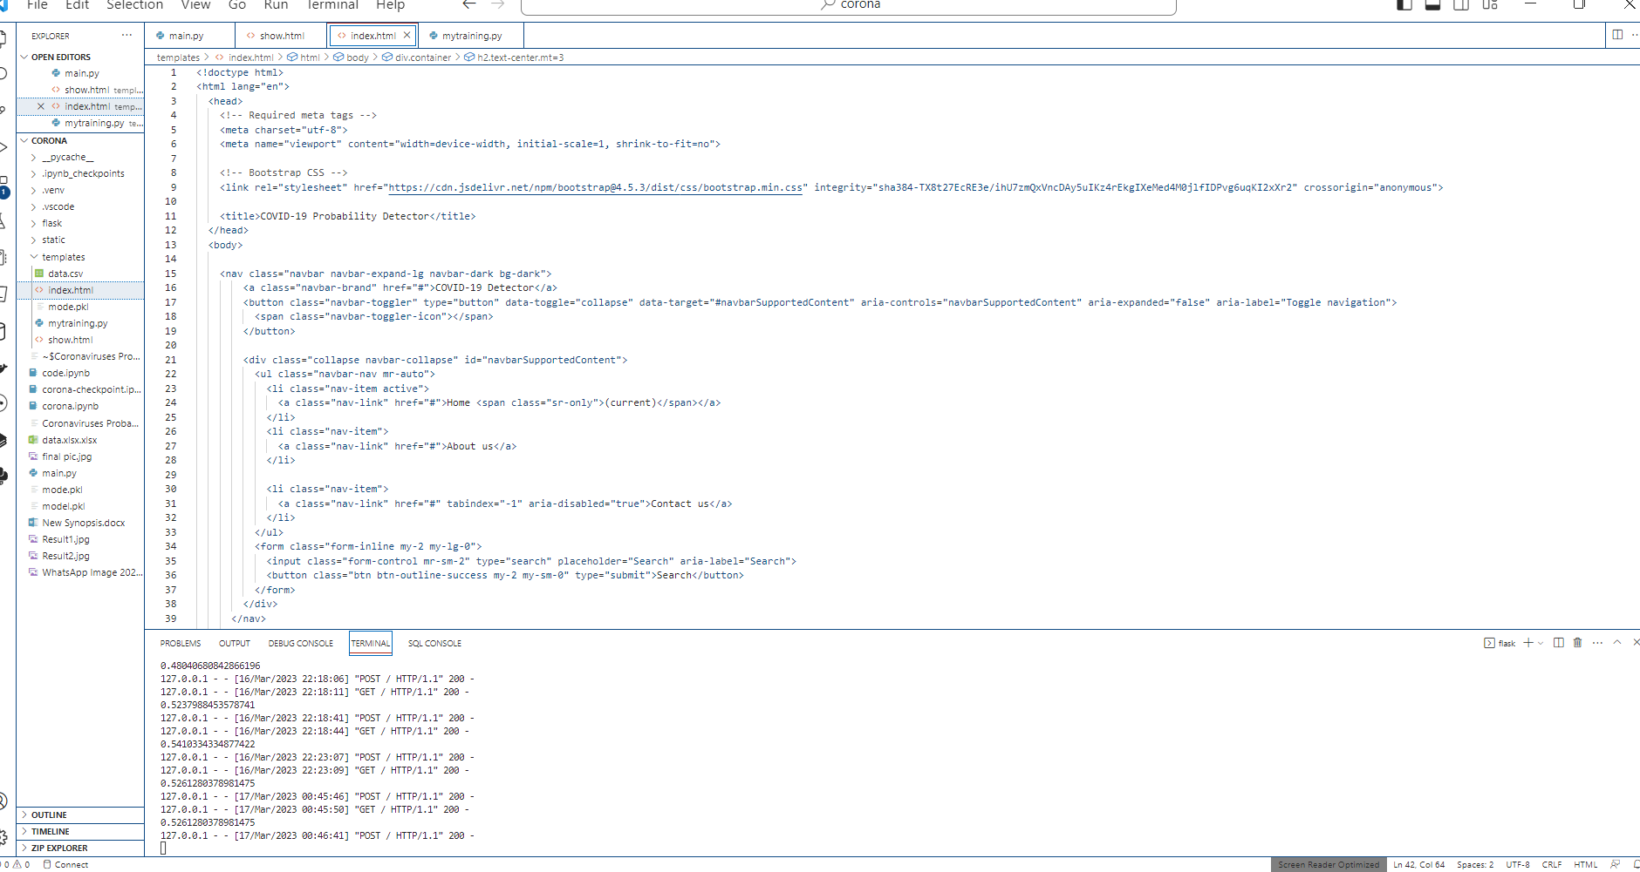
Final Code And Result

Slide 15
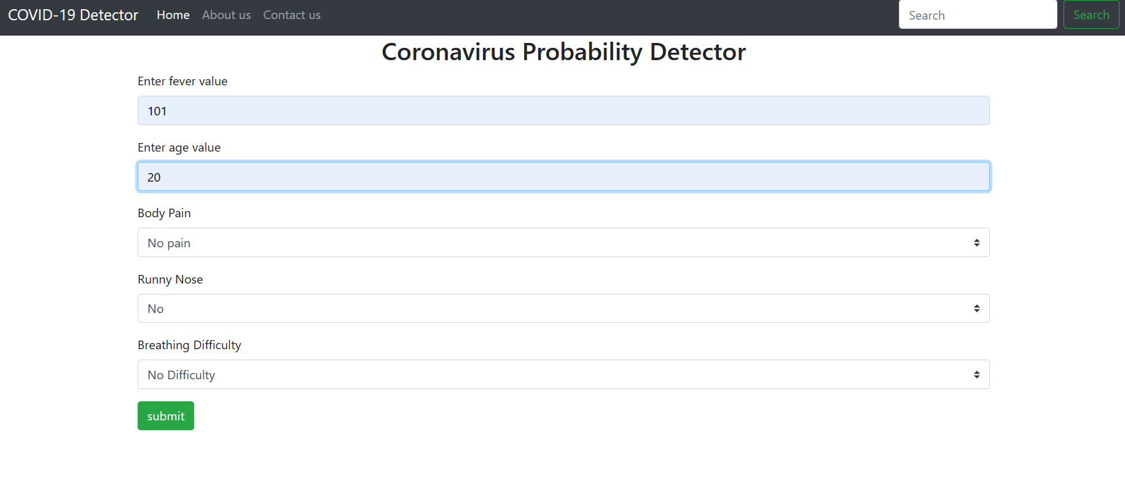
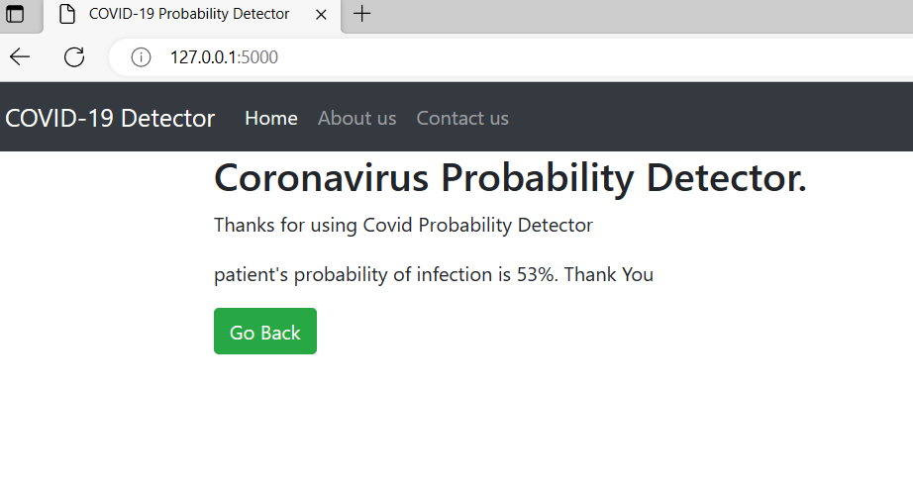

Slide 16
References
1."Covid-19". Oxford English Dictionary (Online ed.). Oxford University Press. April 2020. Retrieved 15 April 2020. (Subscription or participating institution membership required.)
2.^ "Symptoms of Coronavirus". U.S. Centers for Disease Control and Prevention (CDC). 13 May 2020. Archived from the original on 17 June 2020. Retrieved 18 June 2020.
3.^ "Q&A on coronaviruses (COVID-19)". World Health Organization (WHO). 17 April 2020. Archived from the original on 14 May 2020. Retrieved 14 May 2020.
4.^ Jump up to:a b c "COVID-19 Dashboard by the Center for Systems Science and Engineering (CSSE) at Johns Hopkins University (JHU)". ArcGIS. Johns Hopkins University.

Slide 17
Thankyou For Listening to our presentation..Any Queries??

